Slide 1
Rotation summary
Spring 2016 rotation

Slide 2
Enhancer
Gene
Gene
Enhancer
Enhancer
?
?
→What is the most “effective” manner for assigning distal peaks to genes?

Slide 3
Potential methods
eQTLs
Chromosome capture (ChIA-PET / HiC / 5C / etc)

Slide 4
eQTLs
Enhancer
Gene
C
Enhancer
Gene
T

Slide 5
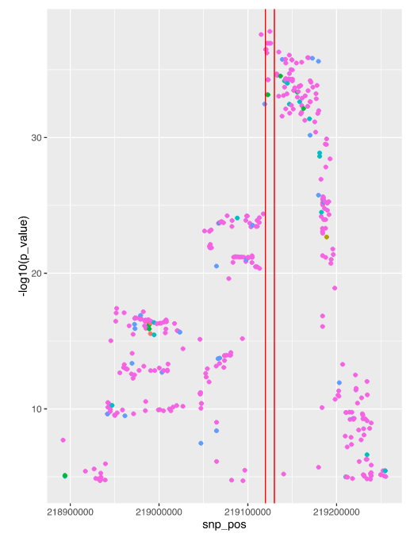
GTEx

Slide 6
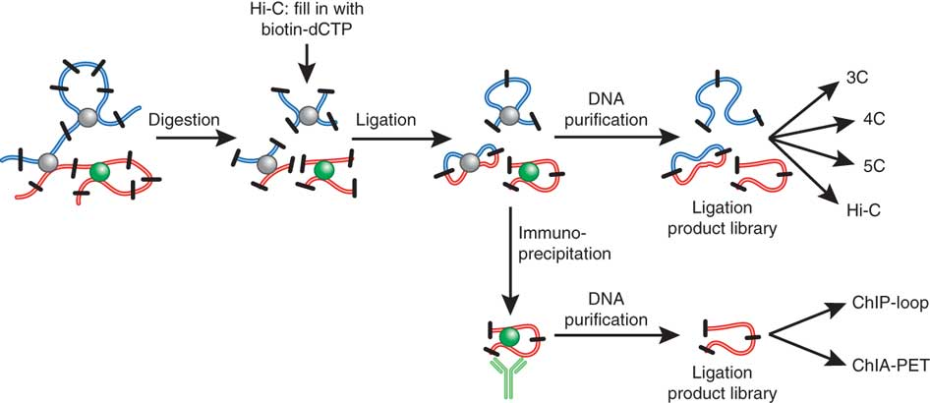
ChIA-PET
Steensel and Dekker 2010. Genomic tools for unraveling chromosome architecture (Nature)

Slide 7
ChIA-PET data sources
ENCODE
3x Pol2
2x CTCF
3x histone marks -- H3K4me1, H3K4me2, H3K4me3
1x Rad21
Young lab
2x Cohesin (hESCs)
Ruan lab (recent publication)
2x CTCF (GM12878, HeLa)
1x Pol2 (HeLa)
Notes:
Mention also how they were processed. ENCODE: I processed with Mango. Young: old version of Mango. Ruan: less statistically stringent one. Ruan data is very deeply sequenced, great resolution

Slide 8
Expanding enhancer lists
Currently FANTOM5
Bi-directional transcription, CAGE
(Extended to 2kb)
ChromHMM (ENCODE)
9 cell types
DNase-seq (ENCODE)
125 cell types

Slide 9
ChromHMM enhancers
DNase
Chromhmm.0
Chromhmm_dnase.0
Chromhmm.2000
Chromhmm_dnase.2000

Slide 10
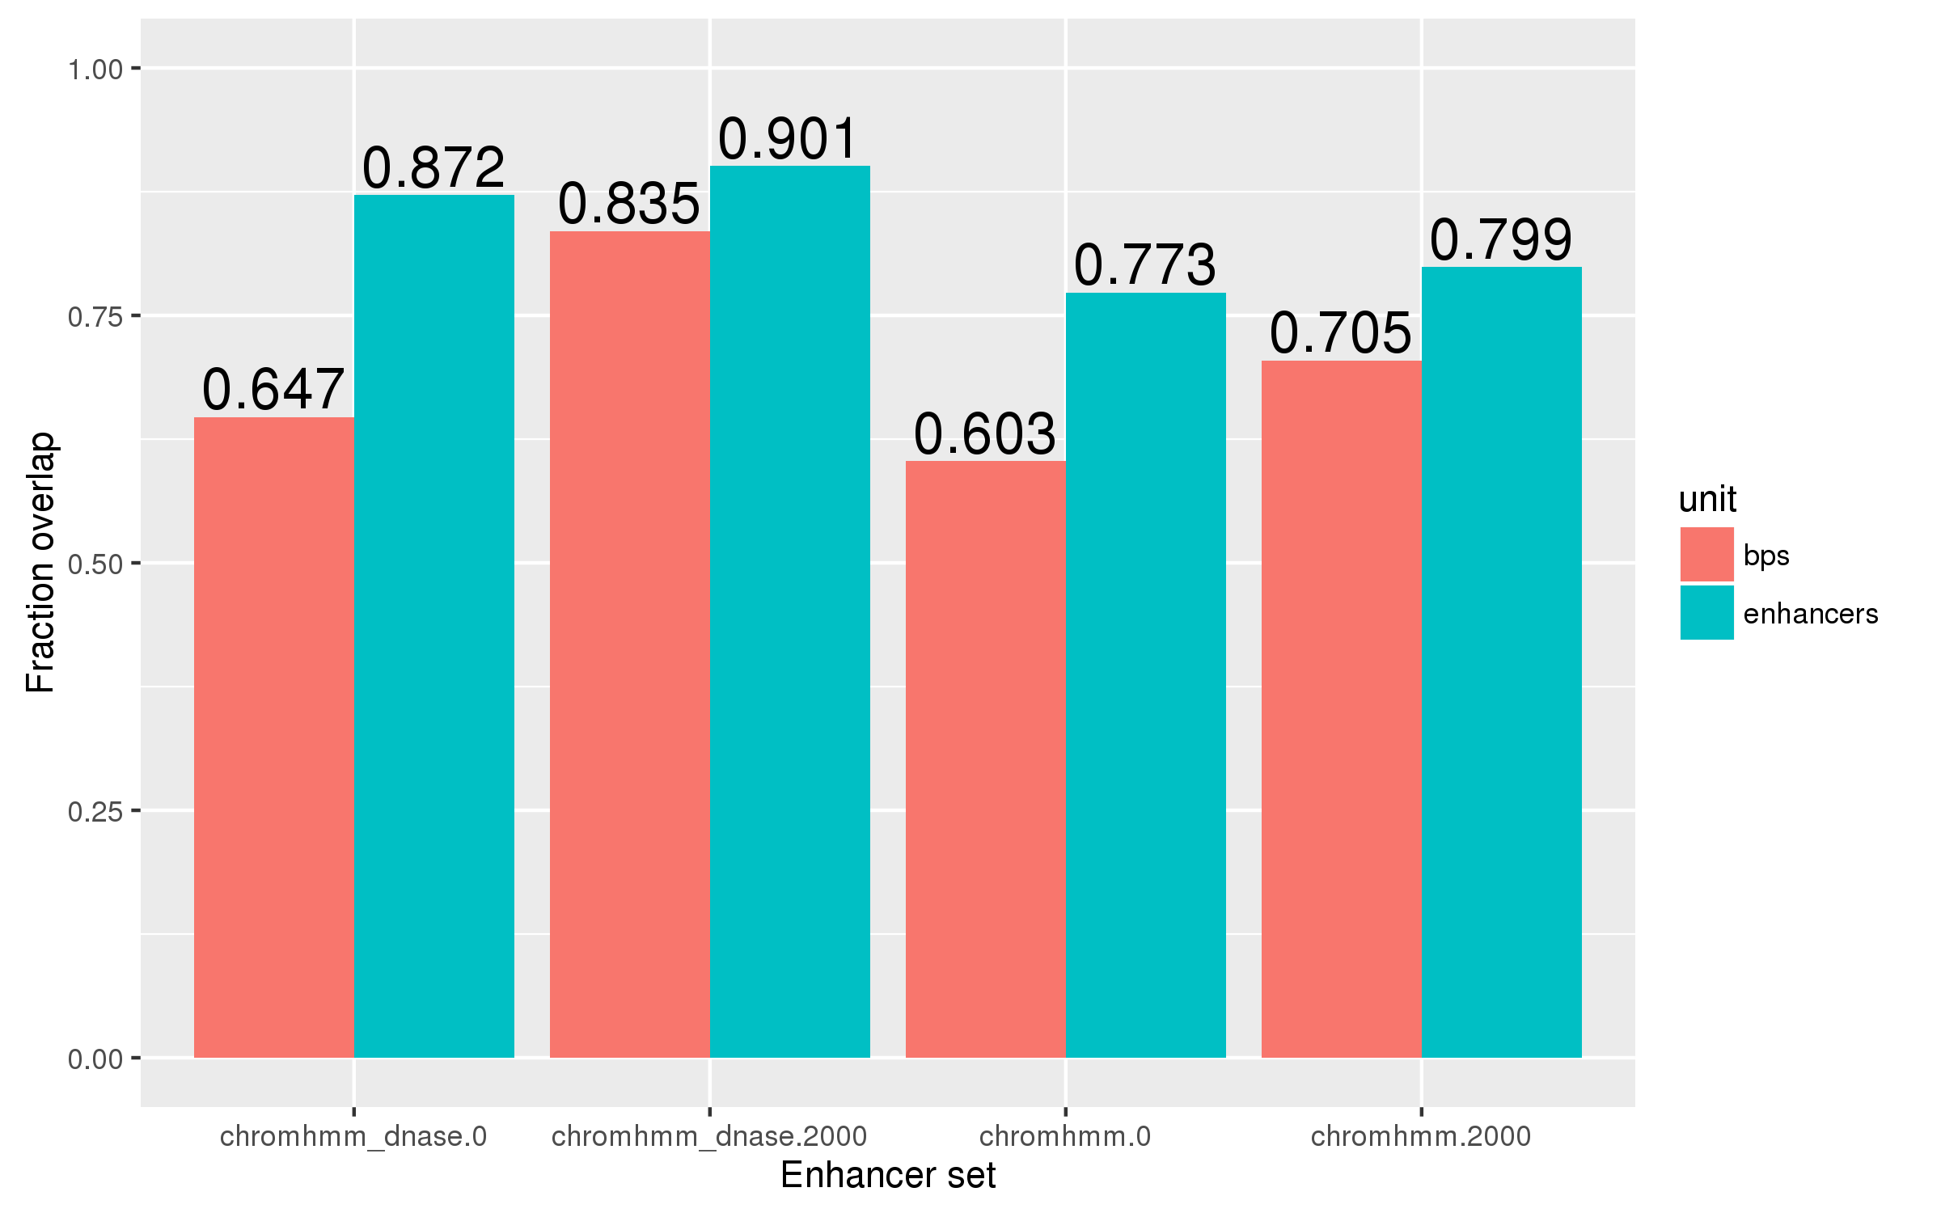
Overlap between old and new
→ e.g., 90.1% of the FANTOM5 enhancer set overlap with at least one of the chromhmm_dnase.2000 set

Slide 11
Total genome coverage

Slide 12
Linking genes to enhancers
Enhancer
Gene
“Point-to-point” (P2P)

Slide 13
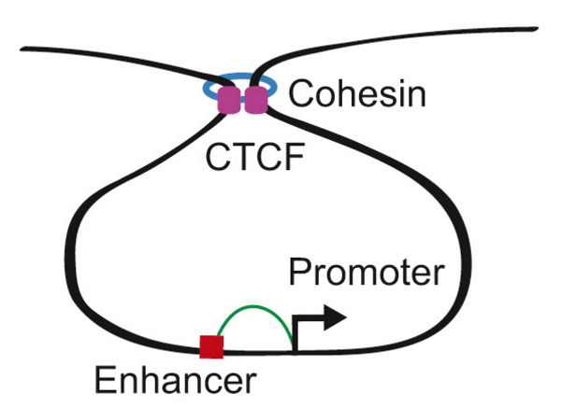
Ji et al 2016 – 3D chromosome regulatory landscape of human pluripotent stem cells

Slide 14
Linking genes to enhancers
Enhancer
Enhancer
Gene
“Encompassing” (E)
(CTCF/Cohesin ChIA-PET only)

Slide 15
Total genome coverage

Slide 17
How well do these definitions capture peaks?

Slide 20
Chipenrich

Slide 21
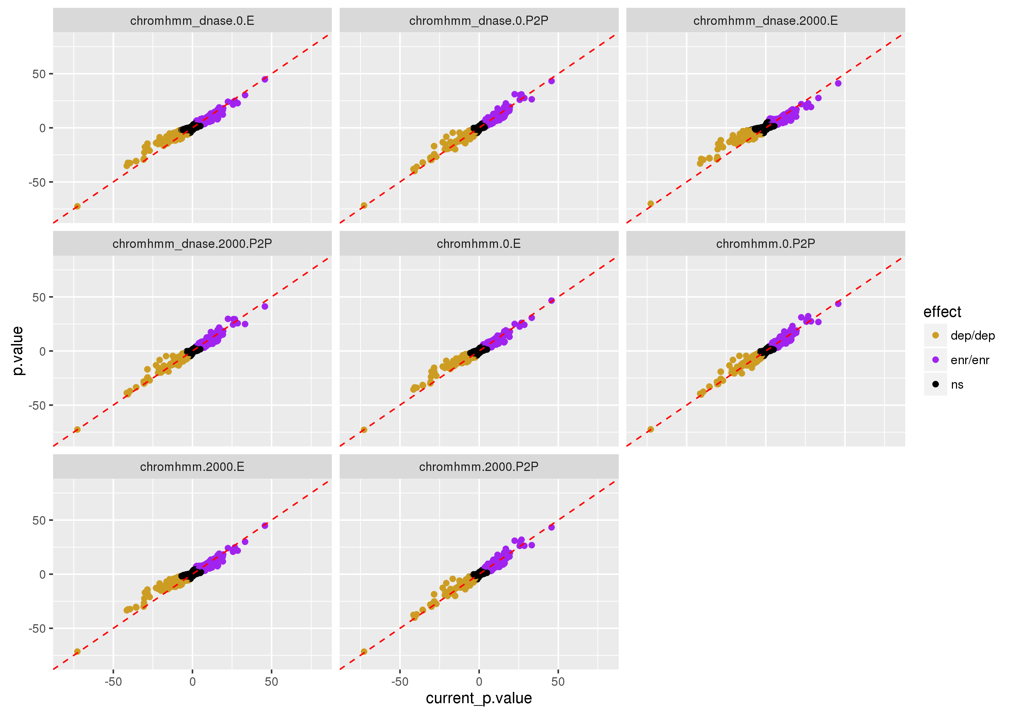
Notes:
Generally, ’E’ does more poorly. This may indicate that looping-based models don’t do as well, which would advise against using TADs…

Slide 22
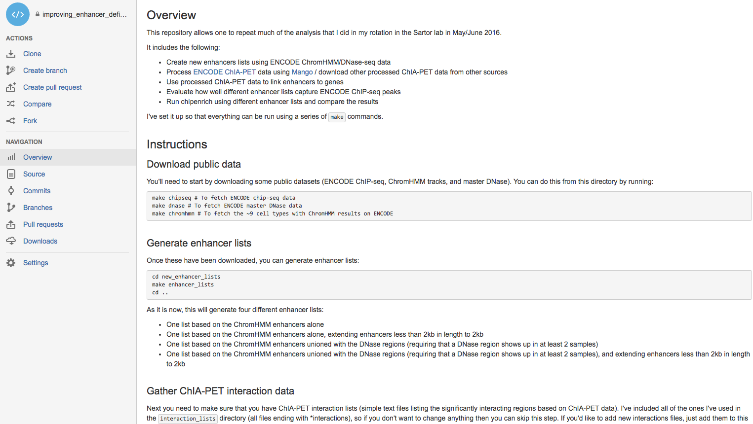

Slide 24
Peak catching

